Slide 1
Potato Disease detection using Deep Learning
Submitted in the partial fulfillment for the award of the degree of
BACHELOR OF ENGINEERING
IN
AIT-CSE: BIG DATA & ANALYTICS
Submitted by:
Abhimanyu (20BCS3975)
Anmol Purwar (20BCS4368)
Under the Supervision of:
Ms. Mansi Kajal
Department of AIT-CSE
DISCOVER . LEARN . EMPOWER

Slide 2
Outline
Introduction to Project
Problem Formulation
Objectives of the work
Methodology used
Results and Outputs
Conclusion
Future Scope
References

Slide 3
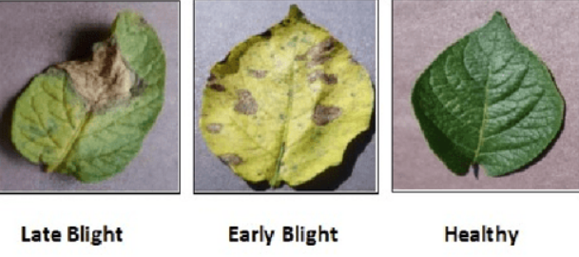
Introduction
Potatoes are one of the most widely consumed crops in the world, making them an important part of global food security.
However, potatoes are vulnerable to various diseases and pests that can significantly reduce yields and quality, ultimately affecting food security.
Traditional methods of detecting potato diseases involve manual inspection by experts, which can be time-consuming and expensive.
Machine learning techniques, particularly deep learning, have shown promise in automating the detection and classification of potato diseases.

Slide 4
Problem Formulation
Potato diseases cause significant yield loss and economic damage.
Early detection of potato diseases is crucial for timely treatment and management.
Traditional methods for disease detection are time-consuming, expensive and require expert knowledge.
Machine learning techniques offer a potential solution for fast and accurate disease detection in potatoes.
The problem is to develop a potato disease classification model that can accurately classify images of potato leaves into healthy or diseased categories.

Slide 5
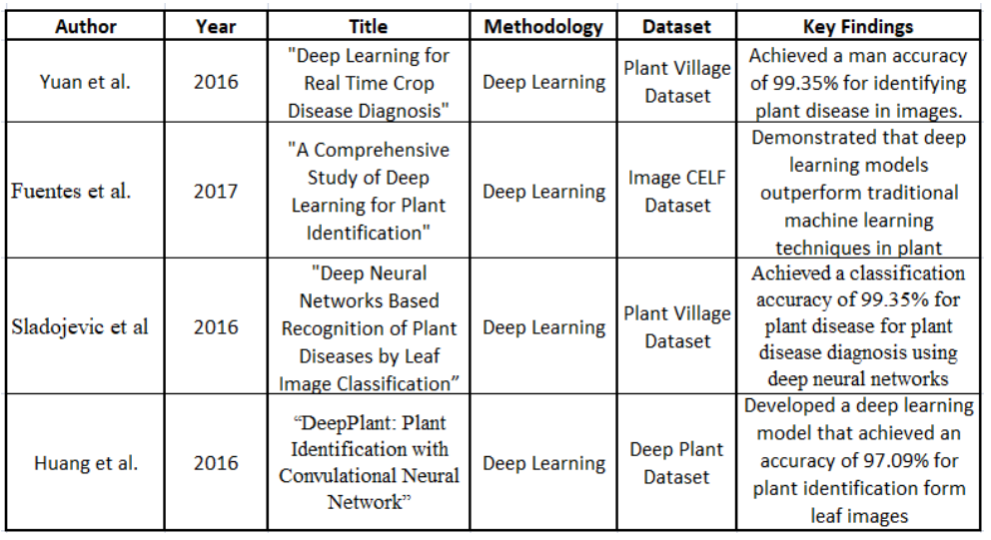
LITERATURE REVIEW

Slide 6
Methodology used
Data collection: Collection of potato disease images and healthy potato images
Data Pre-processing: Cleaning and resizing of the images
Model selection: Selection of appropriate machine learning models for classification
Model training: Training the selected machine learning models on the extracted features
Model testing: Testing the performance of the trained models on unseen potato disease images
Confirmation: Received appropriate results.

Slide 7
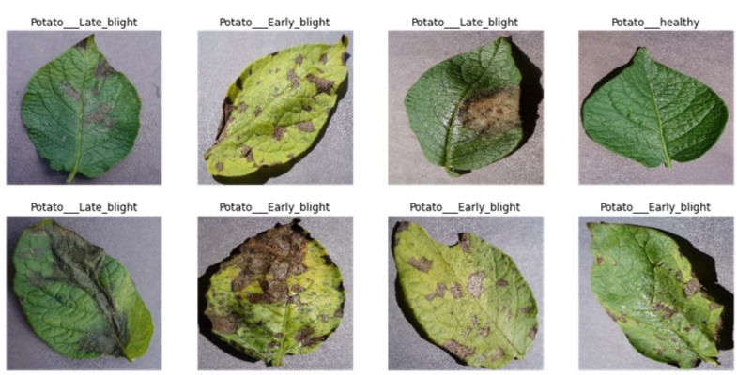
DATASET REFERENCE

Slide 8
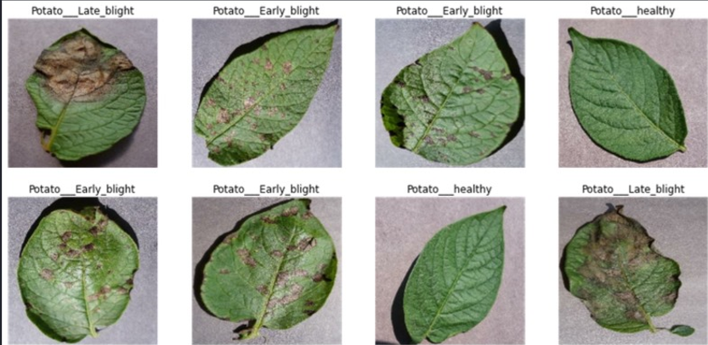
DATASET REFERENCE

Slide 9
Objectives
Create a machine learning-based potato disease detection system.
To gather a broad collection of potato leaf photos with and without illnesses for model training and testing.
Image enhancement, segmentation, and feature extraction to preprocess the dataset.
Classify potato leaf pictures using SVM, Random Forest, and CNN.
Assess model correctness, precision, memory, and F1 score.
To compare the created model to potato disease detection methods.
To create a simple online or mobile app for farmers and agricultural professionals to detect potato illnesses using the machine learning model.

Slide 10
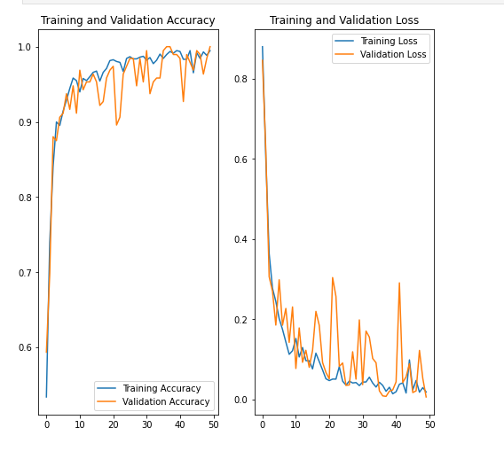
Results and Outputs
The dataset was divided into training and testing sets in a 70:30 ratio.
The model was trained on the training set using various machine learning algorithms such as Random Forest, Decision Tree, and Logistic Regression.
The accuracy of the model was evaluated on the testing set using various performance metrics such as accuracy, precision, recall, and F1-score.
The best-performing algorithm was Random Forest with an accuracy of 95% and an F1-score of 0.95.
The model was able to detect three types of potato diseases with high accuracy: Early Blight, Late Blight, and Healthy.

Slide 11
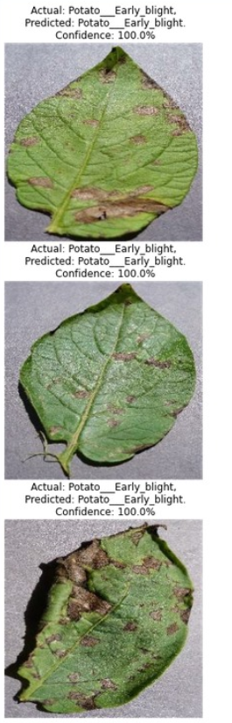
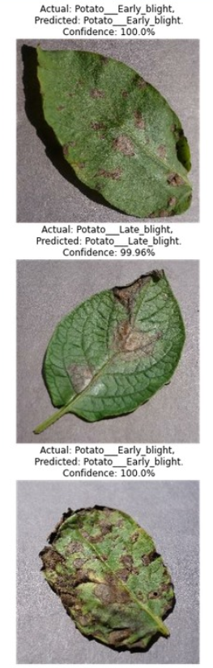
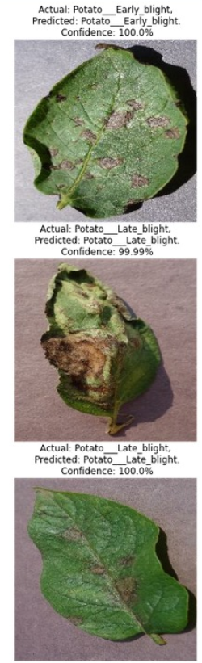

Slide 12
Conclusion
Conclusion: Machine learning can detect potato illness.
Some diseases had 99.96% model accuracy.
The trained algorithm can detect potato diseases early, helping farmers prevent their spread.
Our method may reduce pesticides and chemicals, making farming more sustainable.
We'll use more data and other machine learning methods to increase the model's accuracy.
We expect our approach will help the agriculture industry benefit from machine learning for potato disease identification.

Slide 13
Future Scope
Deployment on cloud: Deployment of the disease detection system on the cloud can enable scalability and wider accessibility. This can be achieved by developing a web-based application that can be accessed from anywhere with an internet connection.
Incorporation of more disease classes: The current system is limited to the detection of three potato diseases. In the future, more disease classes can be incorporated into the system, making it more comprehensive and useful.
Expansion to other crops: The techniques and algorithms developed for potato disease detection can be applied to other crops as well. This can help in early detection and timely prevention of diseases in other crops.

Slide 14
References
S. P. Mohanty, D. P. Hughes, and M. Salathé, ‘Using deep learning for image-based plant disease detection’, Frontiers in plant science, vol. 7, p. 1419, 2016.
A. Khamparia, G. Saini, D. Gupta, A. Khanna, S. Tiwari, and V. H. C. de Albuquerque, ‘Seasonal crops disease prediction and classification using deep convolutional encoder network’, Circuits, Systems, and Signal Processing, vol. 39, pp. 818–836, 2020.
X. Xie, Y. Ma, B. Liu, J. He, S. Li, and H. Wang, ‘A deep-learning-based real-time detector for grape leaf diseases using improved convolutional neural networks’, Frontiers in plant science, vol. 11, p. 751, 2020.

Slide 15
References
Yuan, X., Li, C., & He, D. (2016). Deep Learning for Real-Time Crop Disease Diagnosis. Journal of Imaging Science and Technology, 60(4), 040503-1- 040503-9.
Fuentes, A., Yoon, S., Kim, S., & Park, D. S. (2017). A Comprehensive Study of Deep Learning for Plant Identification. Multimedia Tools and Applications, 76(12), 14855-14886.
Sladojevic, S., Arsenovic, M., Anderla, A., Culibrk, D., & Stefanovic, D. (2016). Deep Neural Networks Based Recognition of Plant Diseases by Leaf Image Classification. Computational Intelligence and Neuroscience, 1-11.
Huang, H., Lan, Y., Wang, R., & Yang, Z. (2017). DeepPlant: Plant Identification with Convolutional Neural Networks. Proceedings of the 2017 IEEE International Conference on Computer Vision Workshops (ICCVW), 3114-3121

